Slide 1
Amazon Web Services

Slide 2
IaaS, PaaS and SaaS
IaaS (Infrastructure as a Service): computing infrastructure, physical or (quite often) virtual machines and other resources like virtual-machine disk image library, block and file-based storage, firewalls, load balancers, IP addresses, virtual local area networks etc. Examples: Amazon EC2, Windows Azure, Rackspace, Google Compute Engine.
PaaS (Platform as a Service): computing platforms which typically includes operating system, programming language execution environment, database, web server etc. Examples: AWS Elastic Beanstalk, Windows Azure, Heroku, Force.com, Google App Engine, Apache Stratos.
SaaS (Software as a Service): access to application softwares often referred to as on-demand softwares. You don't have to worry about the installation, setup and running of the application. Service provider will do that for you. You just have to pay and use it through some client. Examples: Google Apps, Microsoft Office 365.

Slide 3
Regions, Availability zones, Edge locations
Sl.No | CodeName | Location | No of AZ | List of AZs
1 | ap-northeast-1 | Asia Pacific (Tokyo) | 3 | ap-northeast-1a, ap-northeast-1b, ap-northeast-1c
2 | ap-southeast-1 | Asia Pacific (Singapore) | 2 | ap-southeast-1a, ap-southeast-1b
3 | ap-southeast-2 | Asia Pacific (Sydney) | 2 | ap-southeast-2a, ap-southeast-2b
4 | eu-central-1 | EU (Frankfurt) | 2 | eu-central-1a, eu-central-1b
5 | eu-west-1 | EU (Ireland) | 3 | eu-west-1a, eu-west-1b, eu-west-1c
6 | sa-east-1 | South America (Sao Paulo) | 2 | sa-east-1a, sa-east-1b
7 | us-east-1 | US East (N. Virginia) | 5 | us-east-1a, us-east-1b, us-east-1c, us-east-1d, us-east-1e
8 | us-west-1 | US West (N. California) | 3 | us-west-1a, us-west-1b, us-west-1c
9 | us-west-2 | US West (Oregon) | 3 | us-west-2a, us-west-2b, us-west-2c
10 | ? | China (Beijing) Region | 1 | ?
11 | us-gov-west | Gov Cloud(the Northwestern US) Region | 2 | us-gov-west-1, us-gov-west-2

Slide 4
Services Overview
VPC – Virtual Private Cloud
EC2 – Virtual Machines -
IAM – Access Management
S3 – Storage service
Route 53 – DNS service
SES – SMTP service
RDS– Database services
Cloudfront – CDN service
Cloudwatch –
EC2 command line tools
Boto module for Python

Slide 6
VPC
VPC
Subnets
IG
Route tables
NAT Gateways

Slide 7
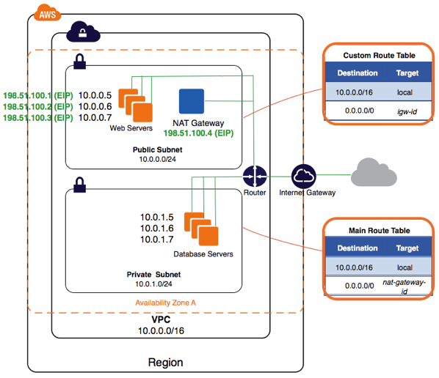
VPC

Slide 8
IP classes
10.0.0.0/8 => 10.0.0.0 - 10.255.255.255
172.16.0.0/12 => 172.16.0.0 - 172.31.255.255
192.168.0.0/16 => 192.168.0.0 - 192.168.255.255
10.0.0.0/12 => 10.0.0.0 - 10.15.255.255
10.16.0.0/24 => 10.16.0.0 - 10.16.0.255
10.17.0.0/16 => 10.17.0.0 - 10.17.255.255
10.18.0.0/20 => 10.18.0.0 - 10.18.15.255

Slide 9
Subnets
Network: 10.10.0.0/16: 10.10.0.0 to 10.10.255.255 (256 X 256)
10.10.0.0/24: 10.10.0.0 to 10.10.0.255 (256 IPs)
10.10.1.0/24: 10.10.1.0 to 10.10.1.255 (256 IPs)

Slide 10
VPC
Created a VPC: 10.10.0.0/16
Created 3 subnets – 1b(10.10.1.0/24), 1c(10.10.2.0/24) and 1d(10.10.3.0/24)
We created one IG, attached the IG to VPC.
Created a RT, added to route (0.0.0.0/0 =➔ IG)
Edited 1d subnet and changed Routing table to the above one.
Launch a machine in 1d subnet.
Created a NAT gateway.
Created a RT, added to route (0.0.0.0/0 =➔ NAT)
Edited 1c subnet and changed Routing table to the above one.
How do I login to machine in 1d.? If I already have a public IP, I can connect using SSH.
How do I login to machines in 1c? Login to the machine in 1d, which has public IP. Then login to machines in 1c.

Slide 11
EC2
Instances - Server Machines
Volume (EBS) – Hard disk
AMI - Images
Security Group – Firewall
Instances – On-demand and Reserved:

Slide 12
EC2 Instances
On Demand
Spot Instances

Slide 13
Assignment for EC2
Create VPC and 5 subnets - 4 private and 2 public.
Setup a wordpress machines on public subnet (apache2, php, php module for apache, mysql, mysql module for php). Setup a separate machine in private subnet for mysql.
Create a loadbalancer (ofcourse in same VPC) and add the Wordpress machines.
Take an image (AMI) of the WP machine. Use this AMI for Autoscaling
Create an autoscaling policy and launch configuration to use the above AMI which you have created (scaleup for above 80%, scale down for below 50%). Minimum size of Autoscaling group will be one. Attach this AS group to same loadbalancer.
Configure a plugin in wordpress that will send static files to an s3 bucket rather than saving them locally. Create an IAM user who has permissions only to the wordpress bucket.
Register for a domain name and use route53 to point your website globally to your LoadBalancer name (CNAME record).
Create a test php script (https://stackoverflow.com/questions/32413576/smtp-authentication-with-php-mail-function ) that will send an email to recipients using SES credentials.
Configure your Wordpress'ss to use SES credentials for sending emails. => https://wordpress.org/plugins/configure-smtp/
Replace mysql instance with an RDS instance.
Cloudwatch will monitor your ec2 instances CPU, DISK usage, etc
Enable cloudfront for your website and configure your website to be serviced by CF.

Slide 14
S3
Storage Service

Slide 15
IAM
Managing users and roles
Policy: What access are allowed to which resources.
Examples:
“Allow s3 bucket READ access”
“grant write access to RDS”

Slide 16
Route53
DNS service provided by AWS
Redundant and scalable DNS service.

Slide 17
SES
SMTP Service in PaaS model

Slide 18
Database services – RDS
Assignment: Create a RDS instance, connect to the database from your own IP address, Create databases and write some data to it
Create machine in the same VPC as the RDS instance.
Install wordpress.
Wordpress on the instance will connect to the RDS database.

Slide 19
Cloudfront
Assignment: Create a cloudfront, host google.com static content in Cloudfront
Load on linux machine: What is the command to see the load. What does the load value indicate.
Using Ec3 command line tools, create an S3 bucket and upload some content
Using ec2 command line tools, create an RDS instance, create VPC, subnets, IW, NAT

